Slide 1


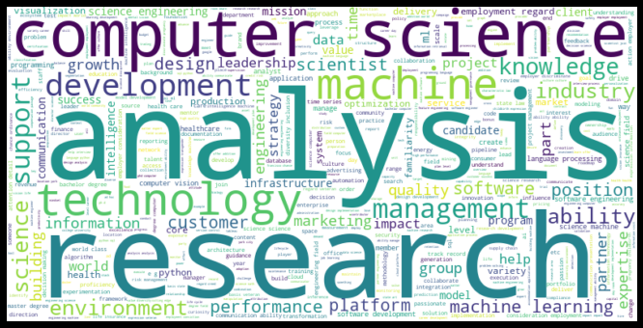
Data Scientist Positions on Indeed.com
By David Wasserman
Notes:
Goal of this presentation: Understand the job market for data scientists in the United States (across 6 diverse job markets).
Note that we will all be looking for a job after the boot camp, so this will give us a leg up although the insights could also be used by requirement writers to generate better job descriptions
Also, take note of the word cloud on the right side. What pops into your head?

Slide 2
Agenda
Project Methodology
Why Indeed?
Cities Analyzed
Statistics for Search Locations
Job Requirements
Minimum Education
Broad-based Skills
Specific Technologies
Salary Information
Companies Looking for Data Scientists
Best Days to Look for a Position
Next Steps
Notes:
I placed the salary information in the middle to keep you on edge.
At the end, hopefully, you will have a better idea of what will help get your hired.
Note: I used Natural Language Processing (NLP) to analyze the job requirements (education, skills, technologies)

Slide 3
Why Indeed?
Indeed.com is a popular web site used by job seekers and job posters to connect with each other.
Of all the job boards, Indeed.com has the most lenient terms and conditions. Indeed does not require credentials to search its listings.
Indeed offers an API although it is limited when it comes to volume. This made Indeed a good candidate for scraping.
Notes:
On the contrary, LinkedIn and Glassdoor do require login information.
Searched for “Data Scientist” across 6 different locations.
On 2/10/2021, I scraped the job description as well as various metadata about the post like company and its metrics, location, remote or not, job title, date posted, and original URL.

Slide 4
Scraping Issues
In order to increase speed, an anonymous proxy was leveraged. However, even with the anonymous proxy, Indeed would throw in CAPTCHA challenges if the network administrators felt that the scraping was automated.
I attempted to use a paid, rotating IP subscription service. However, this did not bear fruit. Thus, I was only able to analyze postings for 6 of the 11 cities I had planned to scrape.

Slide 5
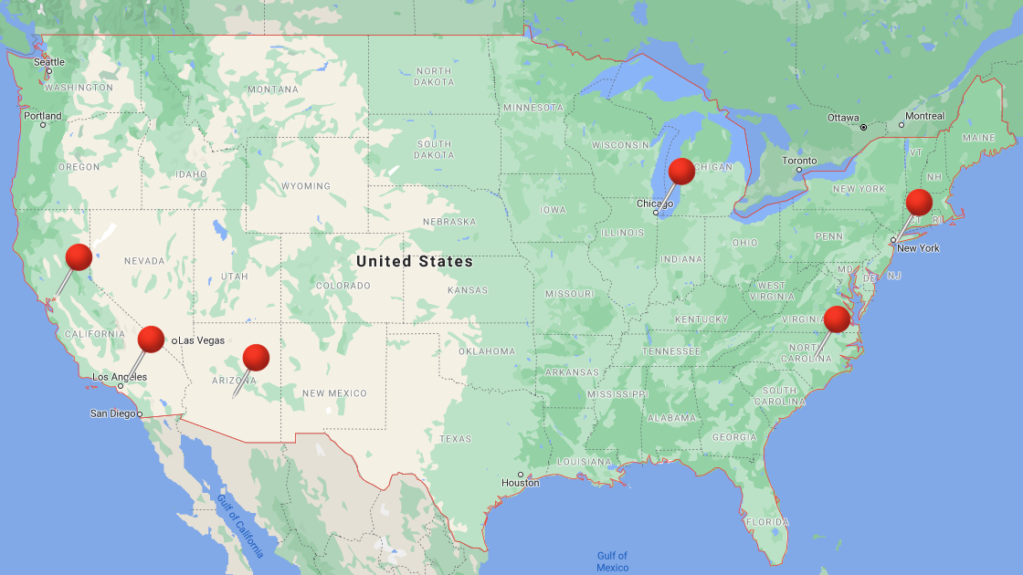
Cities Analyzed
Charlotte, NC
Chicago, IL
Los Angeles, CA
New York, NY
Phoenix, AZ
San Francisco, CA
Notes:
These were based on articles about the hottest locations for data scientists and were geographically distinct. Other cities considered included:
Atlanta, GA
Austin, TX
Boston, MA
Seattle, WA
Washington, DC

Slide 6
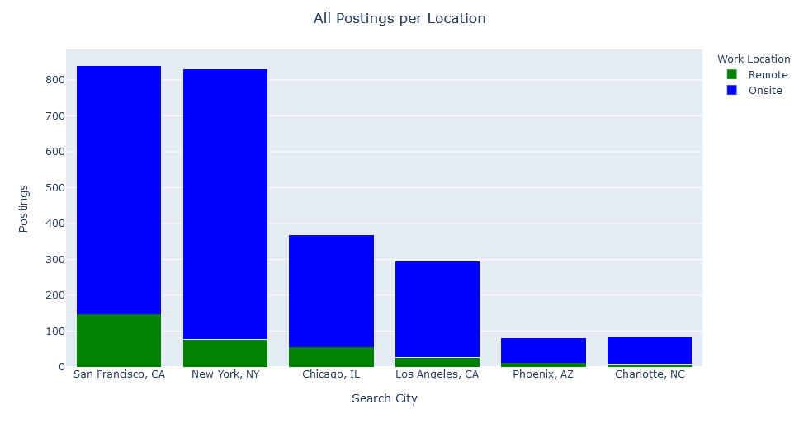
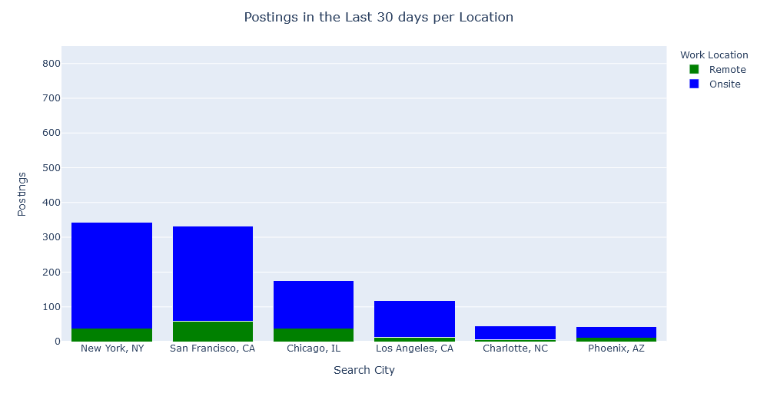
Statistics for the Search Locations
Notes:
Jobs were noted with a location or with a tag of Remote/Temporarily Remote.
Of the 6 cities, most data scientist positions are in San Francisco and New York (significantly insignificant difference). However, San Francisco was more open to remote positions as a percentage, so New York is more geared towards on site work even under COVID conditions.
50% of the jobs are posted within the last 30 days. This shows a large backlog of unfilled jobs that on the market longer than 30 days.

Slide 7
Statistics for the Search Locations
All Data Science Jobs on Indeed
Data Science Jobs Posted in the Last 30 Days
Search City | On Site | Remote | Total
Charlotte, NC | 77 | 8 | 85
Chicago, IL | 314 | 55 | 369
Los Angeles, CA | 269 | 27 | 269
New York, NY | 754 | 77 | 831
Phoenix, AZ | 69 | 11 | 80
San Francisco, CA | 694 | 147 | 841
GRAND TOTAL | 2,177 | 325 | 2,502
Search City | On Site | Remote | Total
Charlotte, NC | 40 | 5 | 45
Chicago, IL | 137 | 37 | 174
Los Angeles, CA | 106 | 12 | 118
New York, NY | 306 | 37 | 343
Phoenix, AZ | 31 | 11 | 42
San Francisco, CA | 273 | 59 | 332
GRAND TOTAL | 893 | 161 | 1,054
Notes:
Jobs were noted with a location or with a tag of Remote/Temporarily Remote.
Of the 6 cities, most data scientist positions are in San Francisco and New York (significantly insignificant difference). However, San Francisco was more open to remote positions as a percentage, so New York is more geared towards on site work even under COVID conditions.
50% of the jobs are posted within the last 30 days. This shows a large backlog of unfilled jobs that on the market longer than 30 days.

Slide 8
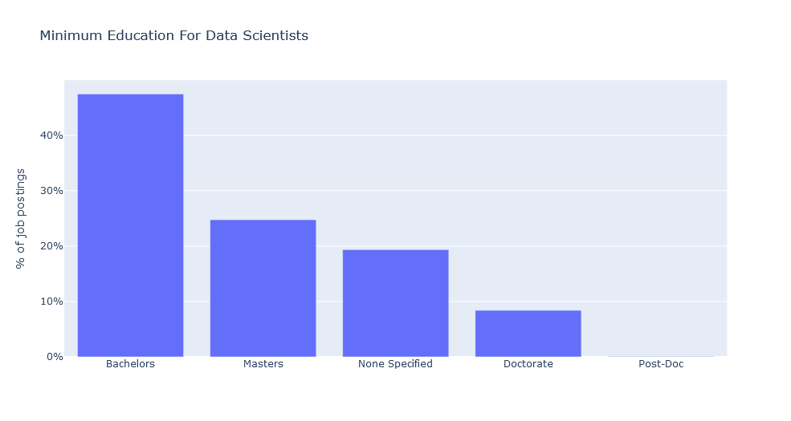
Minimum Education
Notes:
Used NLP to analyze the contents of the job postings
Most jobs require at least a Bachelors degree, followed by a Masters. Roughly 20% do not specify a minimal education while roughly 10% require a doctorate. Only one or two ask for post-doctoral work.

Slide 9
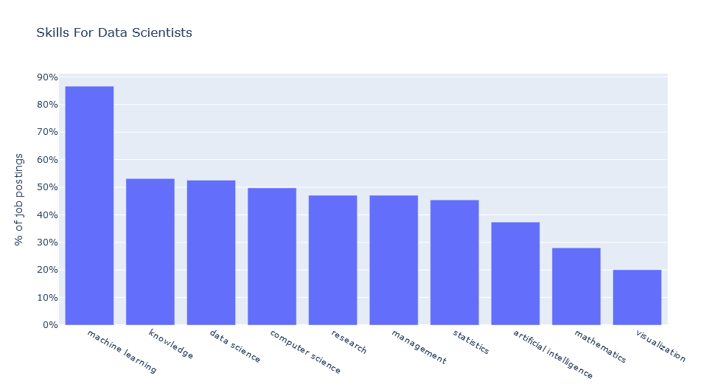
Broad-Based Skills in Demand
Other Popular Skills (in order)
Optimization
Natural Language Processing
Deep Learning
Recommendations
Business Intelligence
Data Mining
Regression
Classification
Forecasting
Neural Network
Notes:
Machine learning is the most important skill for data scientist. This is the BUZZ word.
The next bucket is knowledge and data science.

Slide 10
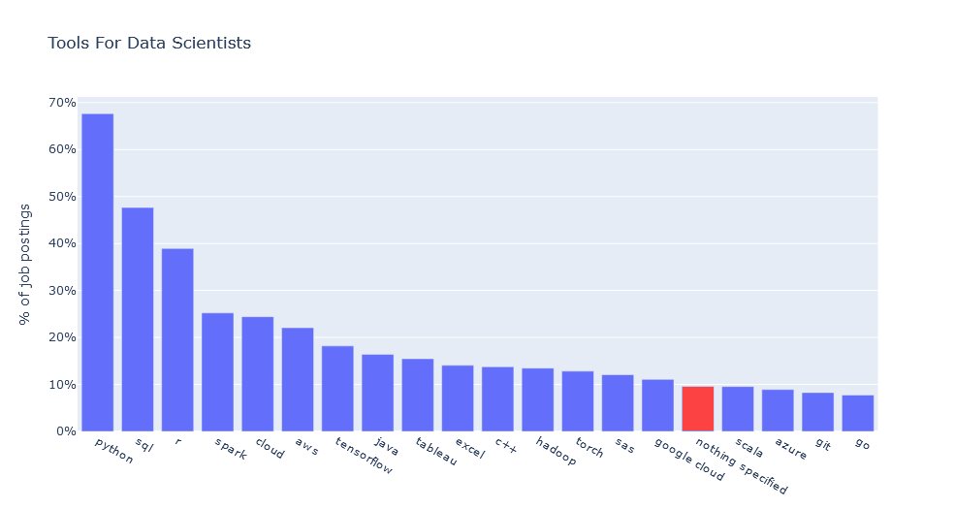
Specific Technologies in Demand
Notes:
Python is the most popular tool of choice, followed by SQL and R.
Roughly 10% of the jobs do not specify the tools in use. Analysis of the posts older than 30 days (9% not specified) vs newer than 30 days (11% not specified) did not yield a significant difference.

Slide 11
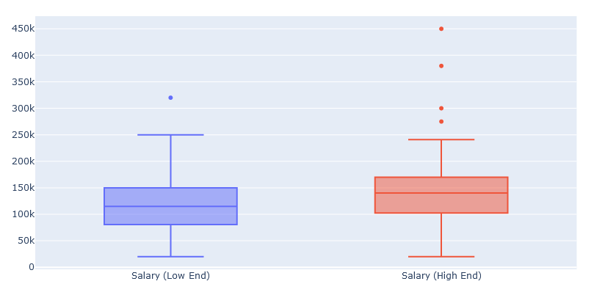
Salary Information
Metric | Annual Salary (Low End) | Annual Salary (High End)
Mean | $115,621 | $145,044
Minimum | $20,000 | $20,000
25% | $80,750 | $103,309
50% | $114,700 | $140,000
75% | $150,000 | $170,000
Maximum | $320,000 | $450,000
n=97 out of 2,502
Notes:
Of the 2,502 job postings, only 97 had salary information. This information came in hourly, monthly, and annual formats, so there was a need to normalize the figures. Of course, pre-hire salary figures are normally negotiable, so that must be taken into consideration.
According to the Bureau of Labor Statistics, men earned a median salary of $55,432 while women made a median salary of $44,564.
https://www.thebalancecareers.com/average-salary-information-for-us-workers-2060808
The average college graduate with at least a bachelor’s degree earned a median salary of $72,020. The average or median salary is much higher for data scientists…
For the four outliers, 2 were posted over 30 days ago. 2 of the 4 are for a car insurance-related company named Blue Owl based in SF, CA. Other outliers were MentorX (SF) and Insight Enterprises (NYC)
¾ of these outlier jobs are remote.

Slide 12
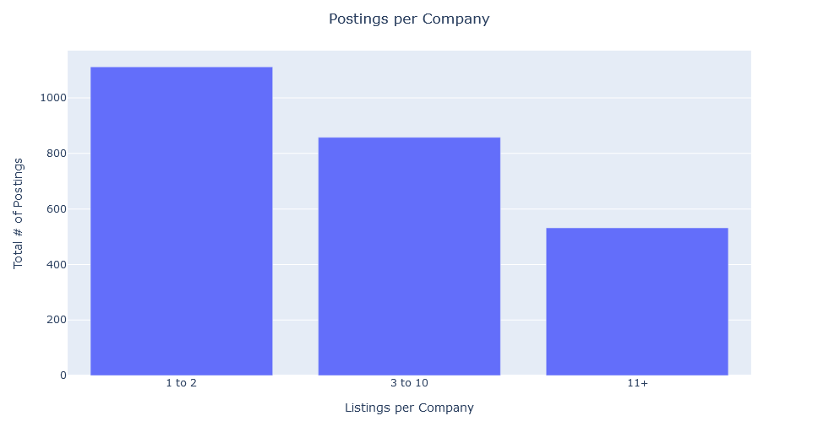
Companies Hiring Data Scientists
# | Company Name | # of Postings
1 | Deloitte | 71
2 | Facebook | 64
3 | Twitter | 31
4 | Uber | 30
5 | Spotify | 28
6 | Accenture | 28
7 | KPMG | 26
8 | Amazon.com Services LLC | 22
9 | Wells Fargo | 21
10 | Bloomberg | 19
There are 1,130 unique companies; 730 have only 1 posting, 321 postings come from companies posting 20 or more posts.
Notes:
If you are looking for kindred spirits, these companies are hiring the highest number of data scientists. Note that they are all large companies.
Since there are at least 1,130 companies looking, there is a vast array of opportunities for data scientists.

Slide 13
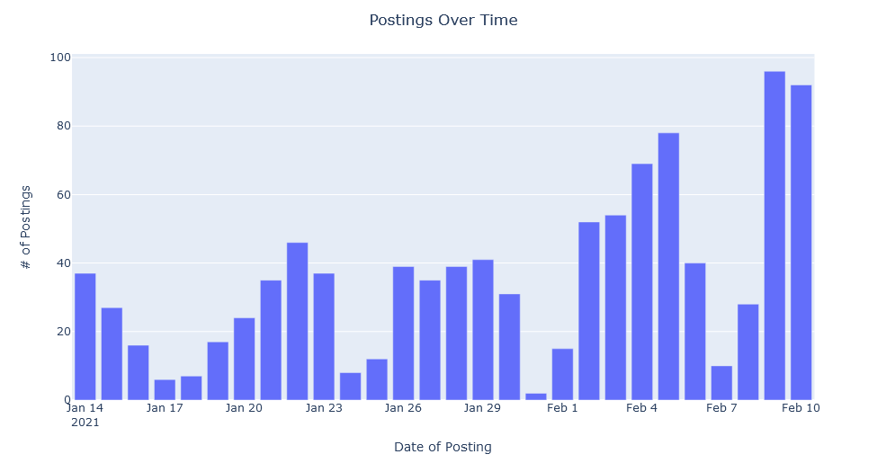
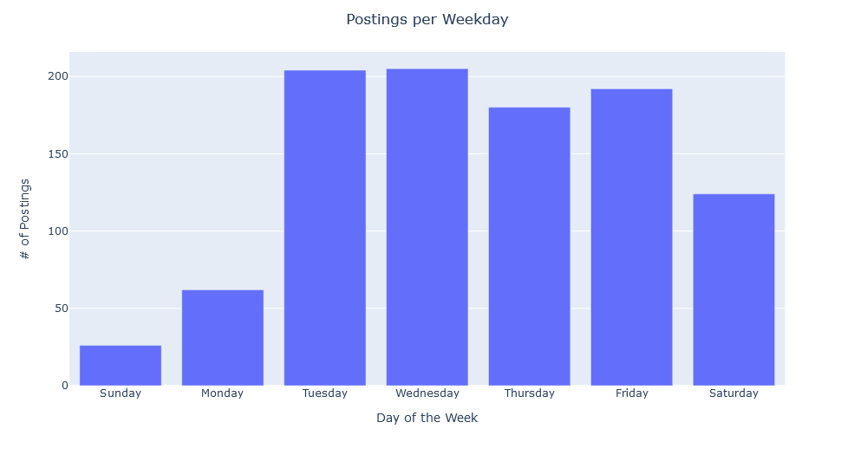
Best Days to Look for a Position
Tuesday and Wednesday have the most postings
Notes:
This article (https://www.fastcompany.com/3044654/why-you-are-most-likely-to-get-hired-on-a-Tuesday) says that most jobs are posted on Tuesday, but my research shows that more jobs are posted on Tuesdays and Wednesdays, followed by Fridays, and then Thursdays. However, the article says that 23.59% of high tech job applicants applied on the first day the job was posted.
This article posits that Monday is the best day: https://ianmartin.com/whats-the-best-day-of-the-week-to-post-a-job-ad/
Methodology: Looked at the last 28 days of postings and group by the day of the week.

Slide 14
Next Steps
Leverage the Indeed API to research other cities
Obtain more salary information for detailed analysis
Analyze the job titles that are in the Data Scientist search
Analyze the type of companies asking for Data Scientists
Notes:
Postings ranged from 282 characters to 19,658 characters. Does text length have an effect on job specification quality?

Slide 15


Slide 16

About Me
Email: davidphilipwasserman@gmail.com
GitHub Repository: https://www.github.com/DPWasserman/indeed-jobs

